Slide 1
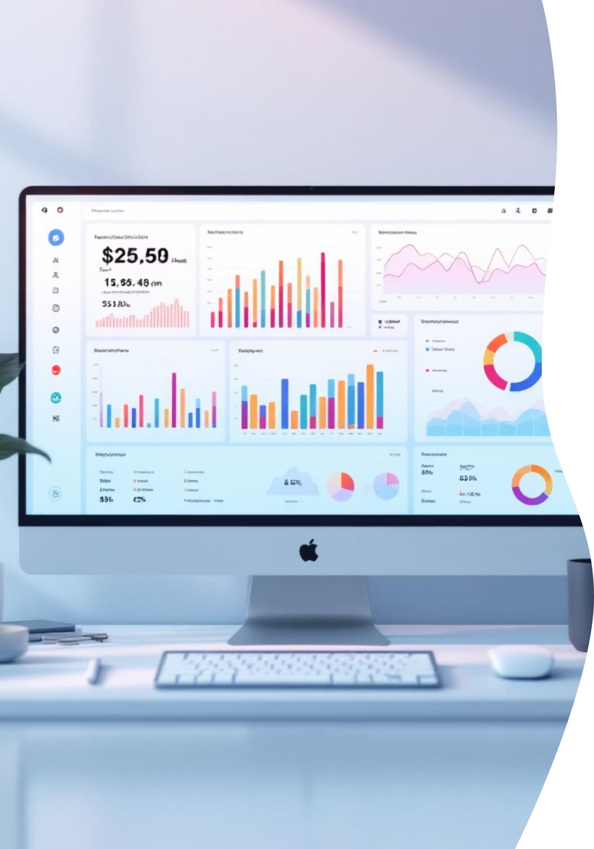
Customer Shopping Behavior Analysis
Analyzing customer shopping behavior from 3,900 transactions, this project uncovers insights into spending patterns, customer segments, product preferences, and subscription trends. These findings will guide strategic business decisions.

Slide 2

Dataset Summary: A Closer Look
3,900 Rows
Comprehensive transactional data.
18 Columns
Rich features including demographics, purchase details, and behavior.
Key Features
Age, Gender, Location
Item, Category, Purchase Amount
Review Rating, Subscription Status
Shipping Type, Discount Applied
Previous Purchases, Frequency
Missing Data
37 values in 'Review Rating' column, handled during cleaning.

Slide 3
Exploratory Data Analysis with Python
01
02
03
Data Loading & Initial Exploration
Missing Data Handling
Column Standardization
Imputed missing Review Rating values using the median rating per product category.
Renamed columns to snake_case for improved readability and consistency.
Imported dataset using pandas and checked structure with df.info() and .describe().
04
05
Feature Engineering
Data Consistency & Integration
Created age_group and purchase_frequency_days columns for deeper analysis.
Dropped redundant promo_code_used and loaded cleaned data into PostgreSQL.

Slide 4
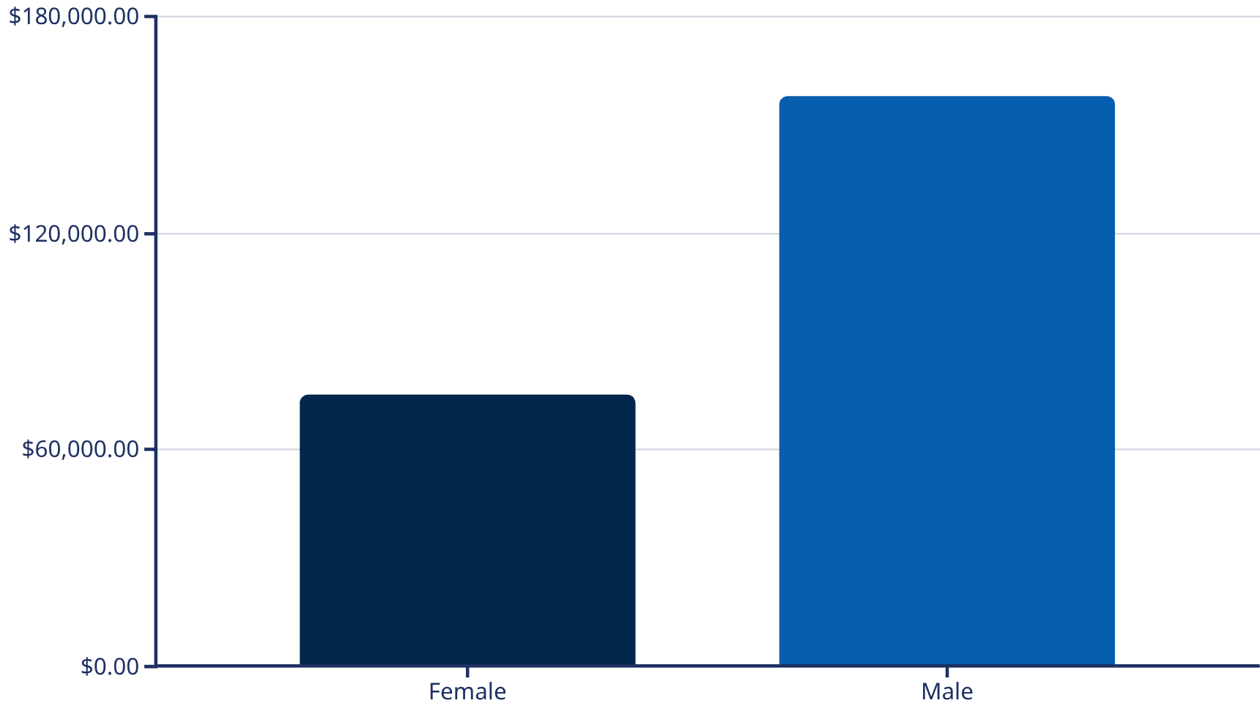

SQL Analysis: Revenue & Discounts
Revenue by Gender
High-Spending Discount Users
Male customers generated significantly more revenue.
839 customers used discounts but still spent above average.

Slide 5




Product Performance & Shipping Insights
Highest-Rated Products
Shipping Spend Analysis
Top Discounted Products
Gloves, Sandals, Boots, Hat, and Skirt received the highest average review ratings.
Express shipping users had a slightly higher average purchase amount ($60.48) than Standard ($58.46).
Hat, Sneakers, Coat, Sweater, and Pants showed the highest percentage of discounted purchases.

Slide 6

Subscription Status & Customer Segmentation
Subscribers vs. Non-Subscribers
Customer Segmentation Overview
Analyzing key metrics across our subscriber base and non-subscribers reveals distinct purchasing behaviors.
Our customer base is segmented to better understand and target different engagement levels:
Status
Customers
Avg. Purchase
Total Revenue
Loyal Customers: 3,116 customers who frequently return.
Returning Customers: 701 customers who have made multiple purchases.
Subscribed
1,053
$59.49
$62,645
New Customers: 83 recent acquisitions.
Not Subscribed
2,847
$59.87
$170,436
While non-subscribers represent a larger customer base and total revenue, average purchase amounts are comparable across both groups.

Slide 7




Top Products by Category
Accessories
Jewelry, Sunglasses, Belt
Clothing
Blouse, Pants, Shirt
Footwear
Sandals, Shoes, Sneakers
Outerwear
Jacket, Coat

Slide 8
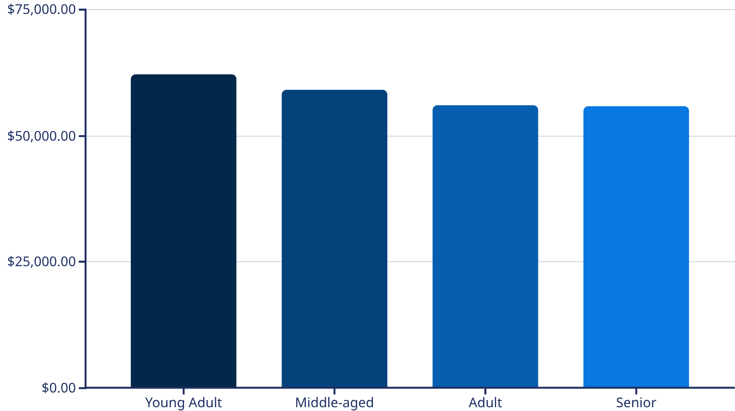

Repeat Buyers & Age Group Revenue
Repeat Buyers & Subscriptions
Revenue by Age Group
Customers making over 5 purchases do not show a higher likelihood to subscribe (958 subscribers vs. 2,518 non-subscribers). This indicates that repeat purchase frequency is not a strong indicator for subscription conversion.
Young Adults generate the highest revenue, closely followed by Middle-aged and Adults.

Slide 9
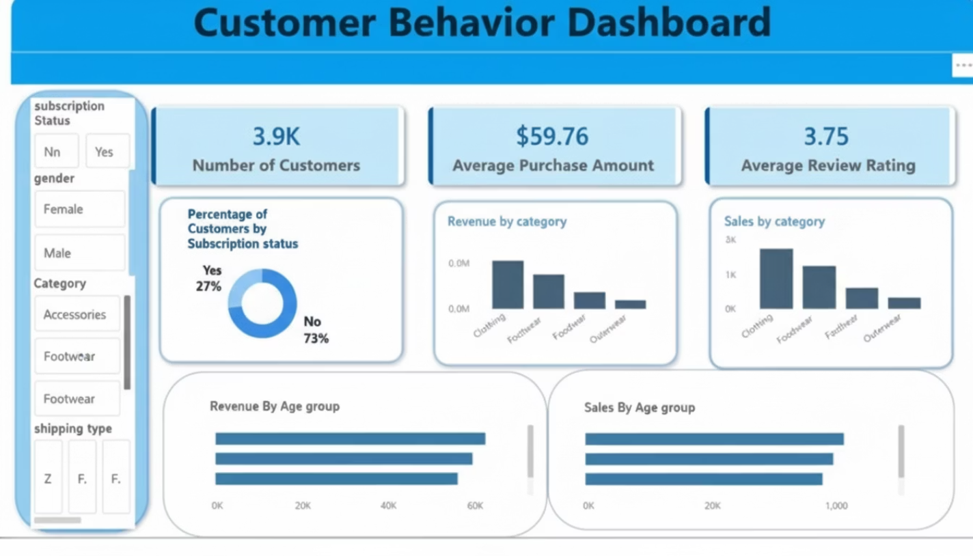
Average Order Value (AOV)
Our recent analysis indicates a stable Average Order Value across various customer segments. This consistency highlights predictable purchasing behavior, allowing us to focus on strategic initiatives designed to incrementally increase transaction values.

Slide 10





Business Recommendations
Boost Subscriptions
Promote exclusive benefits to grow subscriber base.
Customer Loyalty Programs
Reward repeat buyers for loyalty and retention.
Review Discount Policy
Balance sales boosts with margin control for profitability.
Product Positioning
Highlight top-rated and best-selling products.
Targeted Marketing
Target high-revenue age groups and express-shipping users.

